Slide 1
ROCKBUSTER STEALTH LLC
David Aroche
July 13, 2022

Slide 2
Rockbuster in the Industry: Past and… Future?
For many years since its foundation, this company place itself as a market leader by opening several stores around the world for people to have access to their favorite movies and content that was not available anywhere else.
As the internet became more accessible for everyone, the traditional service providers lost advantage against new companies providing the same service through this space; these new companies learnt the advantage of not holding a physical inventory and the fact they can reach to audiences the traditional companies can’t.

Slide 3
Renew or Die: The importance of Change
Why is important to acknowledge Rockbuster's disadvantage and take action on it?
If this company is to survive the onslaught of the new streaming companies such as Netflix and Amazon, and become competitive again, Rockbuster must adapt to the current market dynamics. In that sense, what's the most valuable resource we have and how can we use it in our favour?
All of the movies licenses we have in hands is our must valuable resource. Lunching an online video rental service is what Rockbuster is aming for, but, is this the right way? Let's explore the possibility...

Slide 4
Summarizing Relevant Data If well this is not all the available data, it is the most relevant.
Film licenses | 1000
Rental duration Avg., Max., and Min. | AVG: 2.98 days → 3 days; MAX.: 7 days MIN.: 3 days
Rental rate Avg., Max., and Min. | AVG.: $ 2.98 MAX.: $4.99 MIN.: $0.99
Total Customers | 599
Number of countries with Rockbuster’s operations | 109
1000 films distributed between 5 rates | G, 178 PG, 194 R, 195 NC-17, 210 PG-13, 223
6 different languages: English, French, German, Mandarin, Japanese, Italian | The total amount of films are spoken in English

Slide 5
To plan on Rockbuster’s restructure, first, we must answer some important questions:
Which movies contribute the most and the least to the revenue?
What's the average rental duration?
Which countries are Rockbuster's customers based in?
Where are customers with high lifetime value based?
Do sales figures vary between geographic regions?

Slide 6
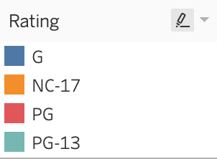
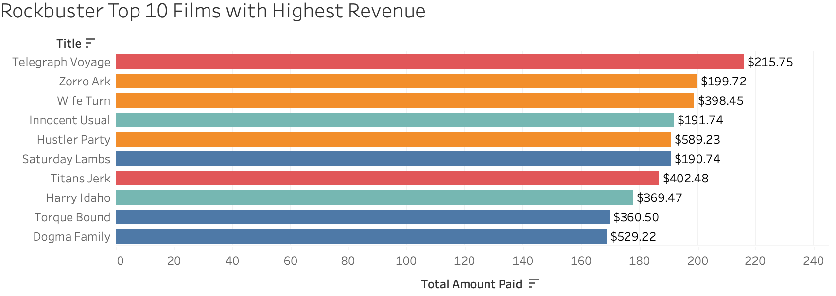
Which movies contribute the most and the least to the revenue?
These are the 10 movies that contributed the most to revenue, and the rating they belong to.

Slide 7
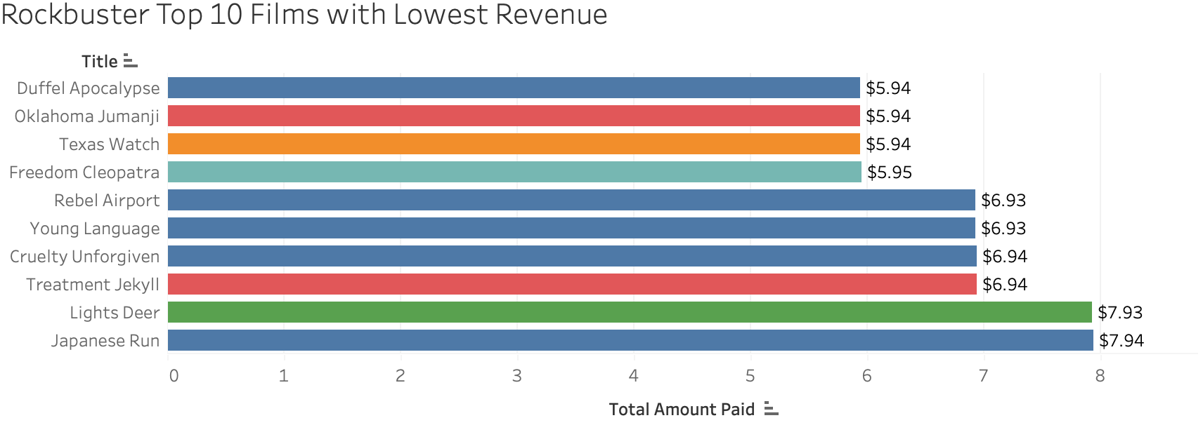
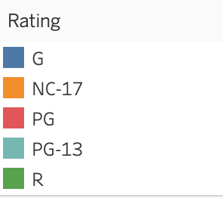
These are the movies that films that collected the least revenue, and the ratings they belong to

Slide 8
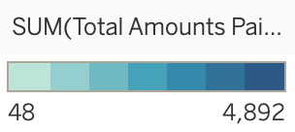
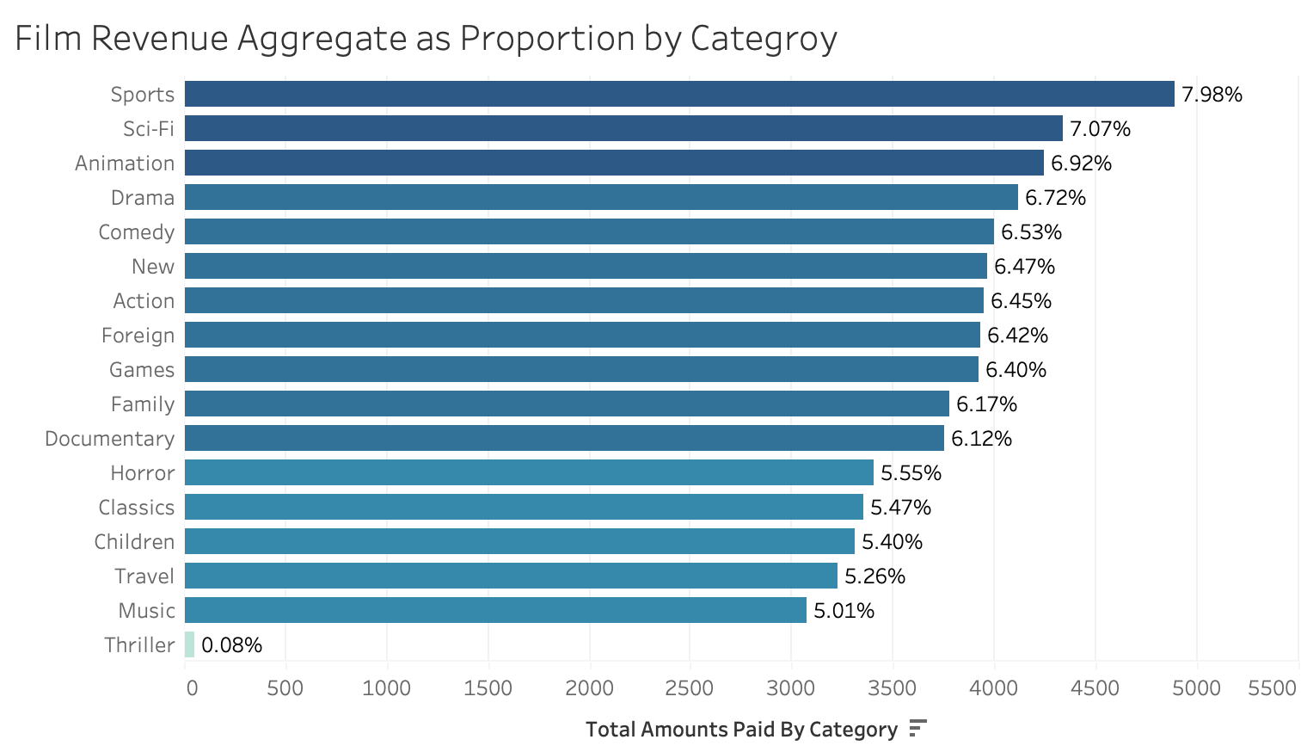
Now, how the aggregate payments look like throughout categories?

Slide 9
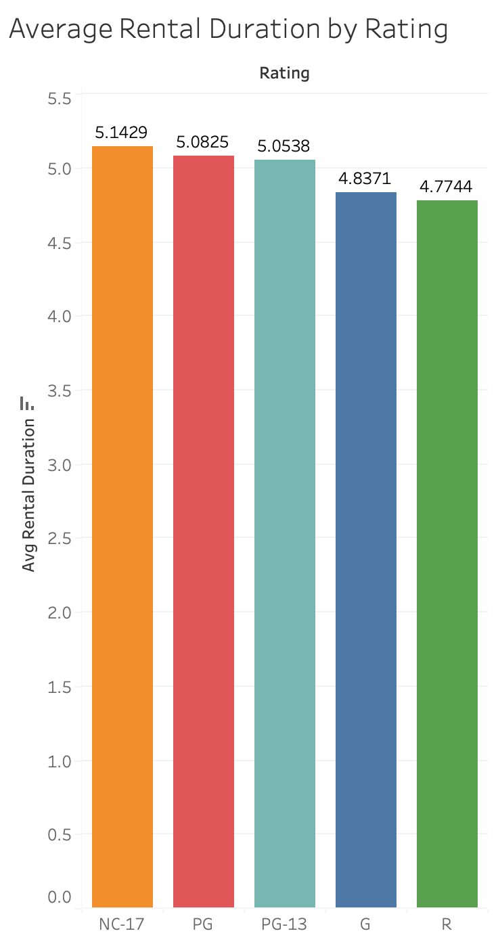
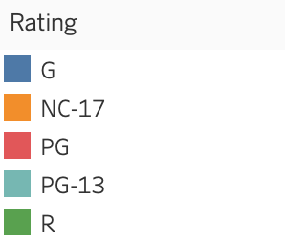
Getting familiar with our audiences
The average rental duration in general terms are 4.985----->5 days, but let’s brake it down even more in terms of average rental duration by category. This will provide us with a graphic idea on which audience is engaging more with Rockbuster’s content.
Where:
G, General Audiences
PG-13, Parental Guidance Suggested
R, Restricted
NC-17, Adults Only

Slide 10
In which countries are Rockbuster's customers based in?
Country ID | Country | Customer Base
44 | India | 60
23 | China | 53
103 | United States | 36
50 | Japan | 31
60 | Mexico | 30
15 | Brazil | 28
80 | Russian Federation | 28
75 | Philippines | 20
97 | Turkey | 15
45 | Indonesia | 14
There are a total of 109 countries contained in the data base, from which:
1 country has no customers
41 countries have only customer
67 countries have 2 or more customers

Slide 11
Customer base around the globe
How our customer base is geographically distributed?
What size it has in each country?
Where are most of the payments coming from?

Slide 12
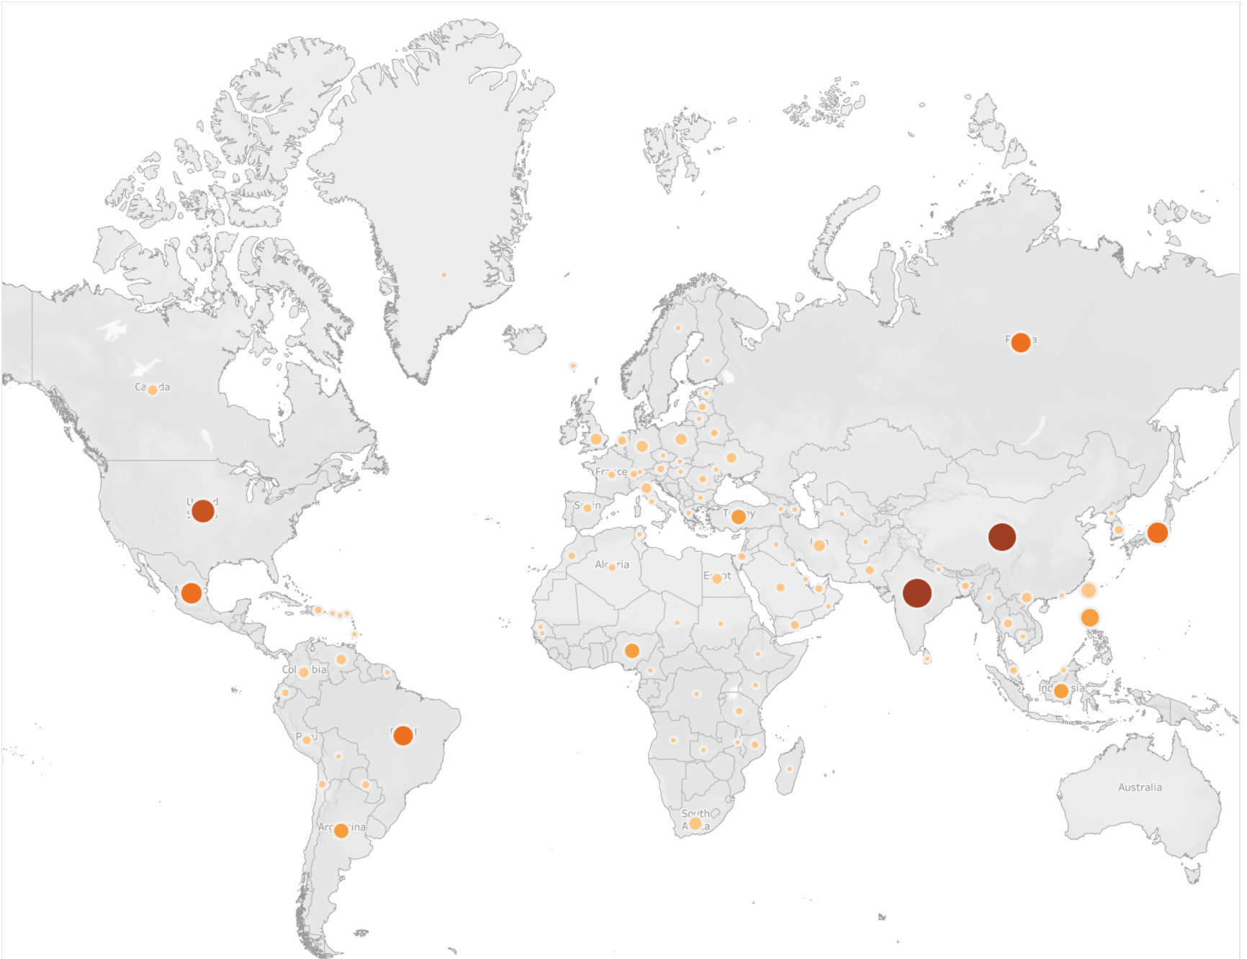
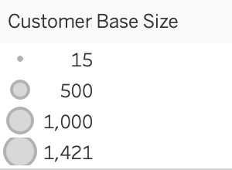
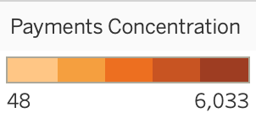

Slide 13
Insights and Observations
If you look at how our customers consume our content based on the film's ratings, you’ll quickly notice that even though the biggest proportion is from adults, the customer base is well distributed, this means, that we have a broad range of content to target several audiences.
Looking at each one of the categories, we clearly can see that Sports, Sci-Fi, and Animation are the big winners, but the rest of the categories don’t fall to far from them. Nonetheless, we have one category that outstands by the lack of impact it has in our revenue; our logic would say to leave it out of the equation, but is this the right move?
It’d be worth to research on how thriller movies do in the streaming platforms and determine if we have a potential new niche or if we should focus on what we currently know but don’t have.
Our customers rented out our content for an average of 5 days, but does this matter considering the transition we are looking to do? It matters if we are looking to migrate a big piece of the business model as is, but it doesn’t if we are to change the whole business model to actually compete with the market leaders.
Online video rental service Vs. Streaming service

Slide 14
RECOMMENDATIONS
First and foremost, I strongly believe in the idea of evolution Rockbuster, not migrating part of the business model into a virtual space. If we keep on operating as we have been since the foundation of the company, it will be virtually impossible to even bridge the gap between Rockbuster and the major streaming services.
Second, even though we have records that we count with content in six different languages, the reality is that all of our content is spoken in one: English. If we are to disrupt the market once again, we must embrace the multicultural world we live in and expand our content not only to the languages we have in pour records, but beyond.

Slide 15
How will we define Rockbuster in the future? What’s the position Rockbuster wants?
Stay behind and secure a market that will allow us to survive for a few more years
Or
Fight for a place in the market that once was ours?

Slide 16
THANK YOU
If you want to explore in depth the data, please feel free to contact me to:
daroche@rockbuster.com
daroche@proton.me
David Guillen Aroche

Slide 17
Links to charts and map
https://public.tableau.com/app/profile/david.aroche/viz/RockbusterTop10FilmswithLowestRevenue/Sheet1?publish=yes
https://public.tableau.com/app/profile/david.aroche/viz/RockbusterTop10FilmswithLowestRevenue/Sheet1?publish=yes
https://public.tableau.com/app/profile/david.aroche/viz/RockbusterAverageRentalDuration/Sheet1?publish=yes
https://public.tableau.com/app/profile/david.aroche/viz/FilmRevenueAggregateProportionbyCategory/Sheet1?publish=yes
https://public.tableau.com/app/profile/david.aroche/viz/RockerbusterFilmAmountRevenueProportionbyRating/Sheet1?publish=yes
https://public.tableau.com/app/profile/david.aroche/viz/CustomerBaseSizePaymentsConcentrationbyCountry/Sheet1?publish=yes

